Slide 1

Personal Details:
Name: Mohammed Farnas Ali Mudabbir
Project: Analysis of superstore
Internship Domain: Data Analytics(DA)
SkillsBuild Email Id: mohdfarnasali@gmail.com
AICTE Student ID: STU644a6a6c2b3391682598508
Internship id: INTERNSHIP_168198413964410a8b547b1
College: Kakatiya Institute of Technology and Science, Warangal
Phone Number: 8008110796
Date: 12.06.2023 to 24.07.2023

Slide 2



SUPERSTORE DATASET ANALYSIS
Presented by:
Mohammed Farnas Ali Mudabbir

Slide 3
Problem Statement:
Identify the key factors influencing sales performance in different product categories .
Analyze customer purchasing patterns and preferences within the Superstore dataset.
Detect anomalies and outliers in the Superstore dataset to identify potential areas of improvement in inventory management
Explore correlations between various demographic factors (e.g., location, income levels).
Forecast future sales trends based on historical data from the Superstore dataset, enabling accurate demand planning, inventory optimization, and resource allocation.

Slide 4
Agenda
Introduction
Data Exploration and Preprocessing
Sales Performance Analysis Customer Analysis
Supply Chain and Inventory Analysis
Conclusion

Slide 5

Introduction
Superstore: A retail store with a wide range of products.
Data: Collected on sales, customer demographics, inventory, and shipping information.
5

Slide 6


1. Sales Performance Analysis. 2. Customer Analysis. 3. Supply Chain and Inventory Analysis. 4. Marketing and Sales Strategy. 5.Recommendations. 6. Forecasting and Predictive Analysis.
Overview of the Dataset analysis.

Slide 7

1. Superstore Management. 2. Sales and Marketing Teams. 3. Supply Chain and Operations. 4.TeamsBusiness Analysts. 5. Executives and Decision-makers. 6. Data Scientists and Analysts.
End users of the dataset analysis

Slide 8

SOLUTION AND ITS VALUE PROPOSITION:
1. Optimize inventory and pricing based on sales data.
2. Create targeted marketing campaigns from customer demographics.
3. Forecast future sales by analyzing sales trends over time.
4. Optimize shipping processes based on shipping data.
5. Identify cost-saving opportunities by analyzing operational costs.
6. Adjust marketing efforts based on marketing data to improve ROI.
7. Improve customer satisfaction by analyzing customer feedback.
8. Identify new product opportunities from customer purchasing behavior.

Slide 9
Relevant Analysis Techniques :
Exploratory data analysis (EDA)
Customer segmentation
Data cleaning and preprocessing
Predictive modeling
Statistical analysis
Text analysis

Slide 10
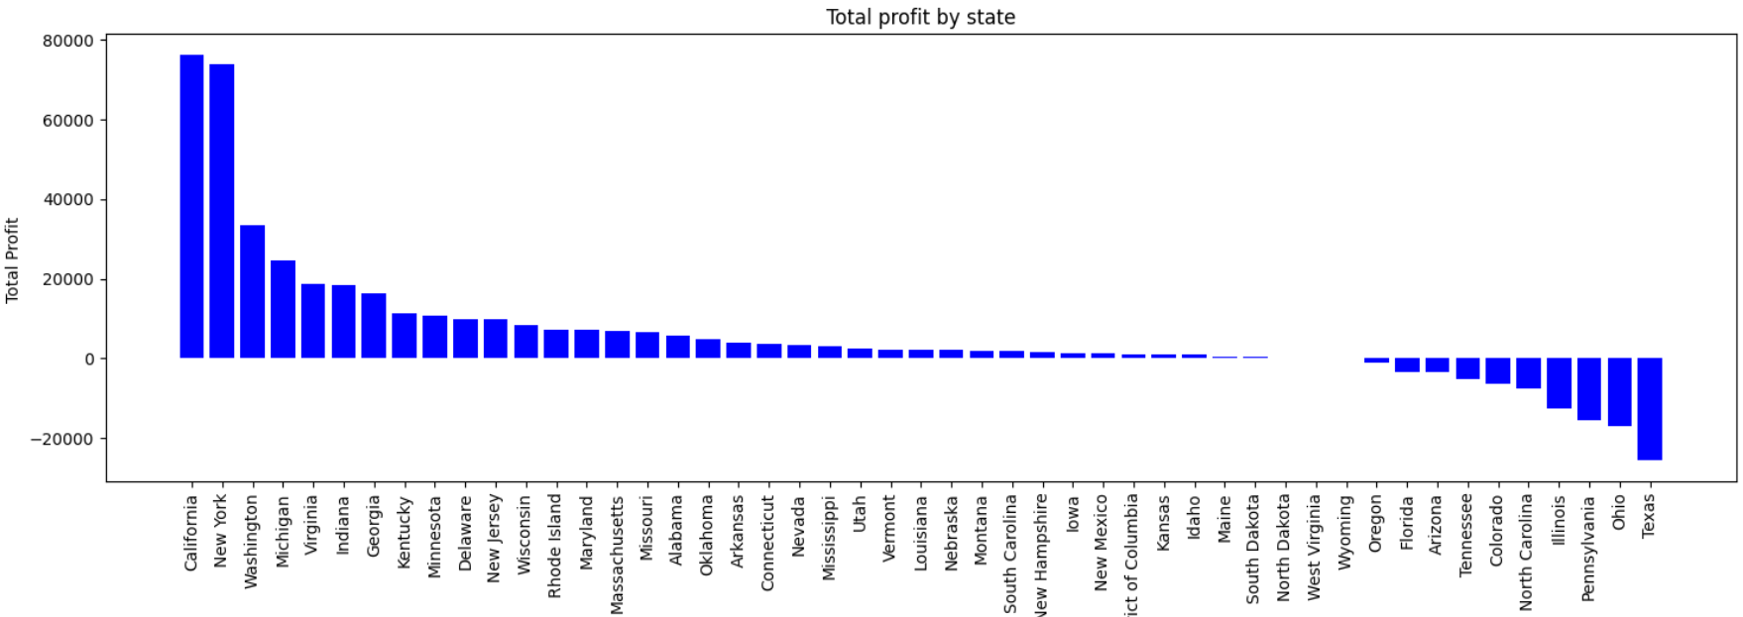
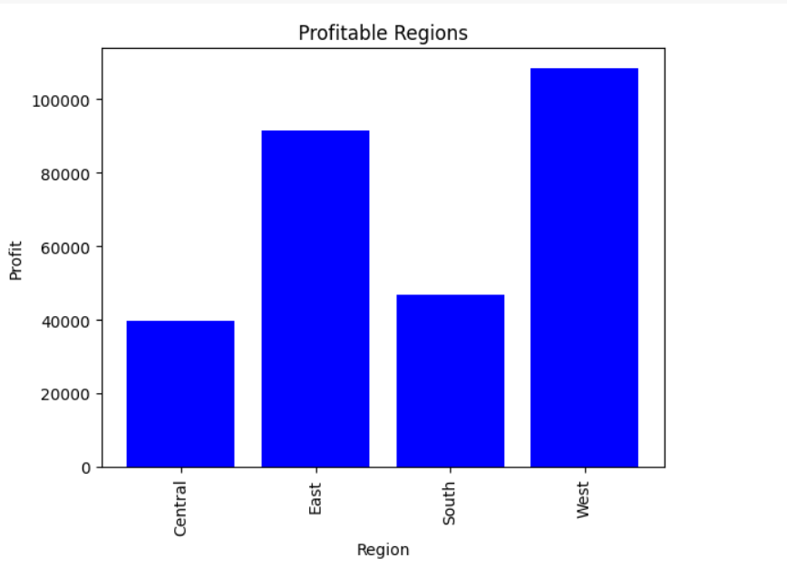
Modelling:

Slide 11
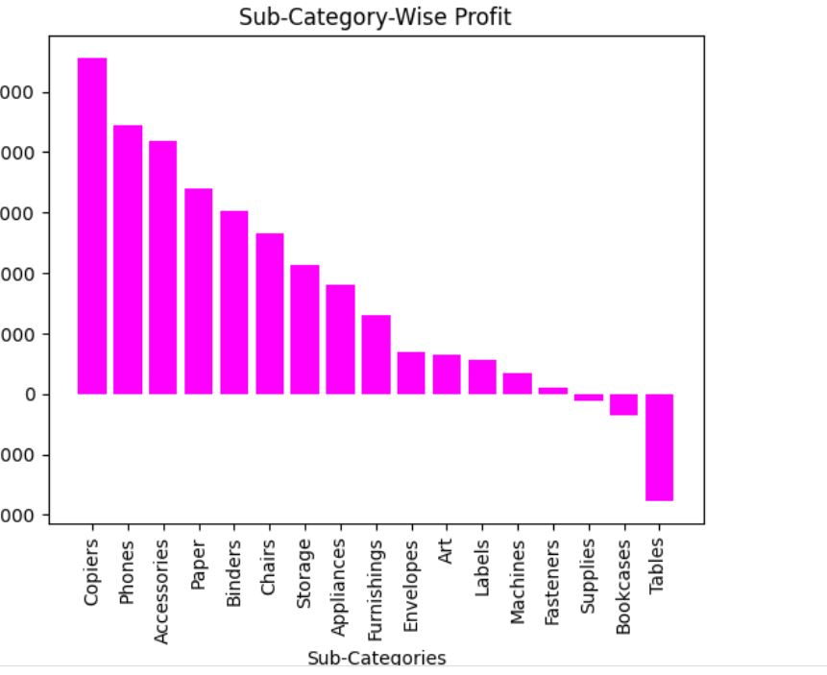
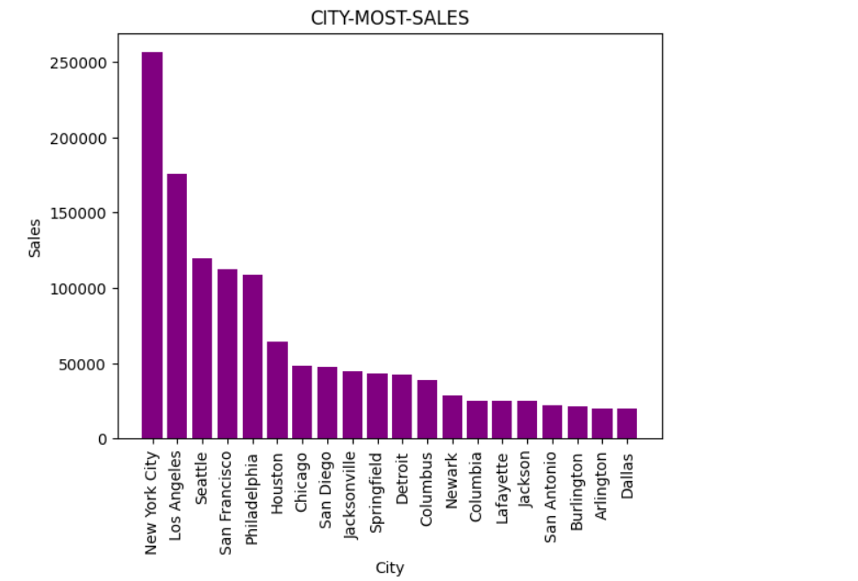
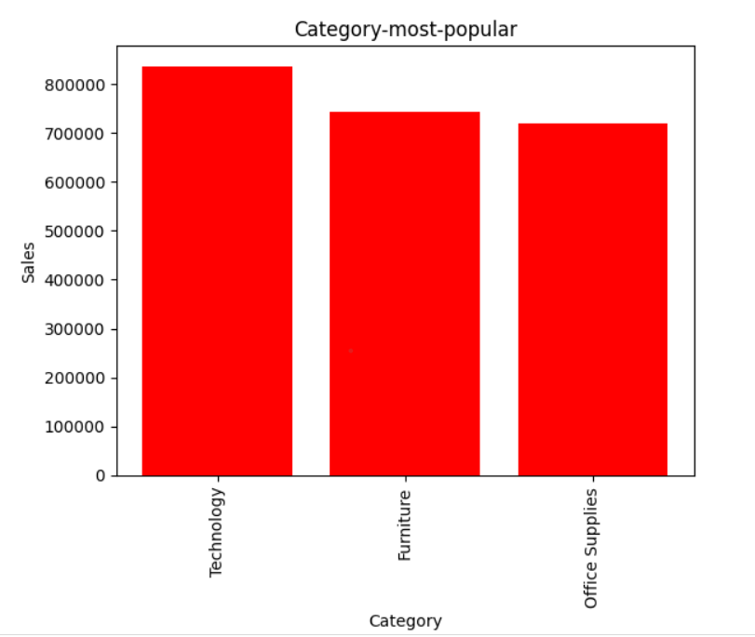
Modelling:

Slide 12

Conclusion
The Superstore dataset is a fictional dataset that contains sales data for a retail company. It includes information about sales, profits, customers, products, and regions. The dataset can be used to analyze sales trends, customer behavior, and other business indicators.
If you provide me with specific instructions on what analysis to perform, I can generate the results based on the Superstore dataset.
12

Slide 13
LINKS:
Git hub : https://github.com/mohammedfarnasali/Analysis-of-superstore-

Slide 14




Thank you

